Slide 1
POLYMORPHISM IN C++:
VIRTUAL FUNCTIONS
2 types
  Compile time polymorphism
    Uses static or early binding
    Example: Function and operator overloading
  Run time polymorphism
    Uses dynamic or early binding
    Example: Virtual functions

Slide 2
POINTERS TO DERIVED CLASSES
C++ allows base class pointers to point to derived class objects.
Let we have –
  class base { … };
  class derived : public base { … };
Then we can write –
  base *p1; derived d_obj; p1 = &d_obj;
  base *p2 = new derived;

Slide 3
POINTERS TO DERIVED CLASSES (CONTD.)
Using a base class pointer (pointing to a derived class object) we can access only those members of the derived object that were inherited from the base.
This is because the base pointer has knowledge only of the base class.
It knows nothing about the members added by the derived class.

Slide 4
POINTERS TO DERIVED CLASSES (CONTD.)
class base {
public:
void show() {
cout << “base\n”;
}
};
class derived : public base {
public:
void show() {
cout << “derived\n”;
}
};
void main() {
base b1;
b1.show(); // base
derived d1;
d1.show(); // derived
base *pb = &b1;
pb->show(); // base
pb = &d1;
pb->show(); // base
}
All the function calls here are statically bound

Slide 5
POINTERS TO DERIVED CLASSES (CONTD.)
While it is permissible for a base class pointer to point to a derived object, the reverse is not true.
  base b1;
  derived *pd = &b1; // compiler error

Slide 6
INTRODUCTION TO VIRTUAL FUNCTIONS
A virtual function is a member function that is declared within a base class and redefined (called overriding) by a derived class.
It implements the “one interface, multiple methods” philosophy that underlies polymorphism.
The keyword virtual is used to designate a member function as virtual.
Supports run-time polymorphism with the help of base class pointers.

Slide 7
INTRODUCTION TO VIRTUAL FUNCTIONS (CONTD.)
While redefining a virtual function in a derived class, the function signature must match the original function present in the base class.
So, we call it overriding, not overloading.
When a virtual function is redefined by a derived class, the keyword virtual is not needed (but can be specified if the programmer wants).
The “virtual”-ity of the member function continues along the inheritance chain.
A class that contains a virtual function is referred to as a polymorphic class.

Slide 8
INTRODUCTION TO VIRTUAL FUNCTIONS (CONTD.)
class base {
public:
virtual void show() {
cout << “base\n”;
}
};
class derived : public base {
public:
void show() {
cout << “derived\n”;
}
};
void main() {
base b1;
b1.show(); // base - (s.b.)
derived d1;
d1.show(); // derived – (s.b.)
base *pb = &b1;
pb->show(); // base - (d.b.)
pb = &d1;
pb->show(); // derived (d.b.)
}
Here,
  s.b. = static binding
  d.b. = dynamic binding

Slide 9
INTRODUCTION TO VIRTUAL FUNCTIONS (CONTD.)
class base {
public:
virtual void show() {
cout << “base\n”;
}
};
class d1 : public base {
public:
void show() {
cout << “derived-1\n”;
}
};
class d2 : public base {
public:
void show() {
cout << “derived-2\n”;
}
};
void main() {
base *pb; d1 od1; d2 od2;
int n;
cin >> n;
if (n % 2) pb = &od1;
else pb = &od2;
pb->show(); // guess what ??
}
Run-time polymorphism

Slide 10
REPRESENTING SHAPES
shape
inherits (isa)
rectangle
• • • •
triangle
circle
square

Slide 11
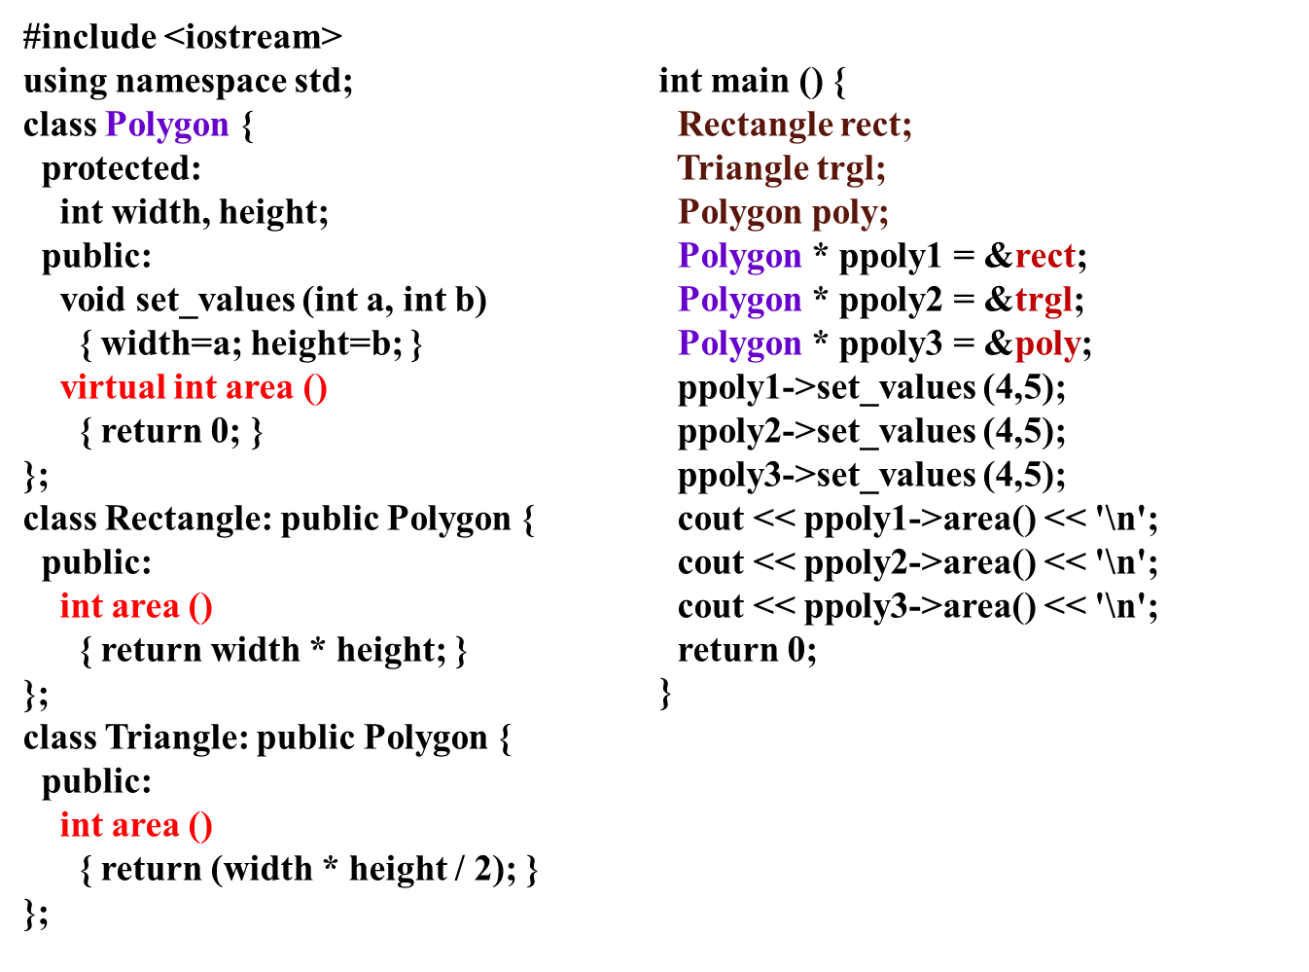
C++ SHAPE CLASSES

Slide 12
VIRTUAL DESTRUCTORS
Constructors cannot be virtual, but destructors can be virtual.
It ensures that the derived class destructor is called when a base class pointer is used while deleting a dynamically created derived class object.

Slide 13
VIRTUAL DESTRUCTORS (CONTD.)
class base {
public:
~base() {
cout << “destructing base\n”;
}
};
class derived : public base {
public:
~derived() {
cout << “destructing derived\n”;
}
};
void main() {
base *p = new derived;
delete p;
}
Output:
  destructing base
Using non-virtual destructor

Slide 14
VIRTUAL DESTRUCTORS (CONTD.)
class base {
public:
virtual ~base() {
cout << “destructing base\n”;
}
};
class derived : public base {
public:
~derived() {
cout << “destructing derived\n”;
}
};
void main() {
base *p = new derived;
delete p;
}
Output:
  destructing derived
  destructing base
Using virtual destructor

Slide 15
MORE ABOUT VIRTUAL FUNCTIONS
If we want to omit the body of a virtual function in a base class, we can use pure virtual functions.
  virtual ret-type func-name(param-list) = 0;
It makes a class an abstract class.
  We cannot create any objects of such classes.
It forces derived classes to override it.
  Otherwise they become abstract too.

Slide 16
MORE ABOUT VIRTUAL FUNCTIONS (CONTD.)
Pure virtual function
  Helps to guarantee that a derived class will provide its own redefinition.
We can still create a pointer to an abstract class
  Because it is at the heart of run-time polymorphism
When a virtual function is inherited, so is its virtual nature.
We can continue to override virtual functions along the inheritance hierarchy.

Slide 17
FINAL COMMENTS
Run-time polymorphism is not automatically activated in C++.
We have to use virtual functions and base class pointers to enforce and activate run-time polymorphism in C++.

Slide 18
APPLYING POLYMORPHISM(SUMMARY)
Early binding
  Normal functions, overloaded functions
  Nonvirtual member and friend functions
  Resolved at compile time
  Very efficient
  But lacks flexibility
Late binding
  Virtual functions accessed via a base class pointer
  Resolved at run-time
  Quite flexible during run-time
  But has run-time overhead; slows down program execution

Slide 19
FRIEND FUNCTIONS AND FRIEND CLASSES
By default : functions and data of a class are private to that class
Only the public members are accessible outside the class
Protected members can be inherited along with public members
No such condition where private members can be accessed from outside the class
So Friend Functions and Friend Classes may be used where our application requires the access all the members of a class

Slide 20
FEATURES OF FRIEND FUNCTIONS:
Not a member of the class
Invoked like normal function without any object
Full access to private and protected members
Of the class
But can use the members for one or more specific objects
Called without the use dot operator(does not need to be qualified with object’s name)

Slide 21
HOW TO DECLARE?
Include its prototype in the class , preceding it with keyword friend
Syntax:
friend ret_type func_name(arguments);
Can be declared anywhere (in public, protected or private section) in the class
May have no arguments
Objects of the class or their pointers can be passed as arguments to the friend function

Slide 22
EXAMPLE:
Class myclass
{ int a,b;
Public:
myclass(int x,int y)
{ a=x; b=y; }
friend int sum(myclass m); // declaration
}
int sum(myclass m)
{ return m.a+ m.b; }
void main()
{ myclass my(10,20);
cout<<sum(my); //calling the friend function
}

Slide 23
USAGE OF FRIEND CLASSES:
As a function can be friend of more than one class, it can be used for message passing between the classes.
As it is not a member of the class ,it does not have a this pointer. So can be used for Operator overloading. The operands are passed explicitly to the overloaded friend operator function.
Make I/O functions easier

Slide 24
EXAMPLE: Function As Friend Of More Than One Class
class A; // forward declaration
class B
{
int b;
friend int sum(A a1, B b1);
};
class A
{
int a;
friend int sum(A a1, B b1);
};
int sum (A a1,B b1)
{
return a1.a + b1.b;
}

Slide 25
FRIEND CLASSES
One class friend of another class
Syntax: friend class class_name;
The friend class and all of its member functions have access to the private members defined within the other class
Provides additional functionality from outside the class

Slide 26
EXAMPLE: FRIEND CLASSES
Class one
{ int a;
friend class two;
};
Class two
{ void disp(one o1)
cout<<o1.a;
};
main()
{
two t;
one o;
t.disp(o);
}

